Slide 1




Data Loading

Slide 2

Objective & Outline
Page 01

Slide 3
Objective & Outline
Objective
Understand what Data Loading is and how to do Data Loading for data analysis and modeling needs using the popular Pandas library.
Outline
What is Data Loading
Review Pandas
Page 02

Slide 4
What is Data Loading?
Page 03

Slide 5
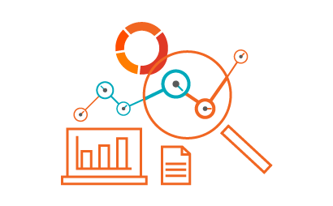
What is data loading?
Data loading is the process of copying and loading data or data sets from a source file, folder or application to a database or similar application. It is usually implemented by copying digital data from a source and pasting or loading the data to a data storage or processing utility.
Page 04

Slide 6

What is data loading?
Data is the gold of an AI/ML Engineer/Data Scientist, so knowing many approaches to loading data for analysis and modeling is crucial.
One of approaches is using Pandas as a very popular data manipulation library, and it is very commonly used in industry.
Page 05

Slide 7
Review Pandas
Page 06

Slide 8
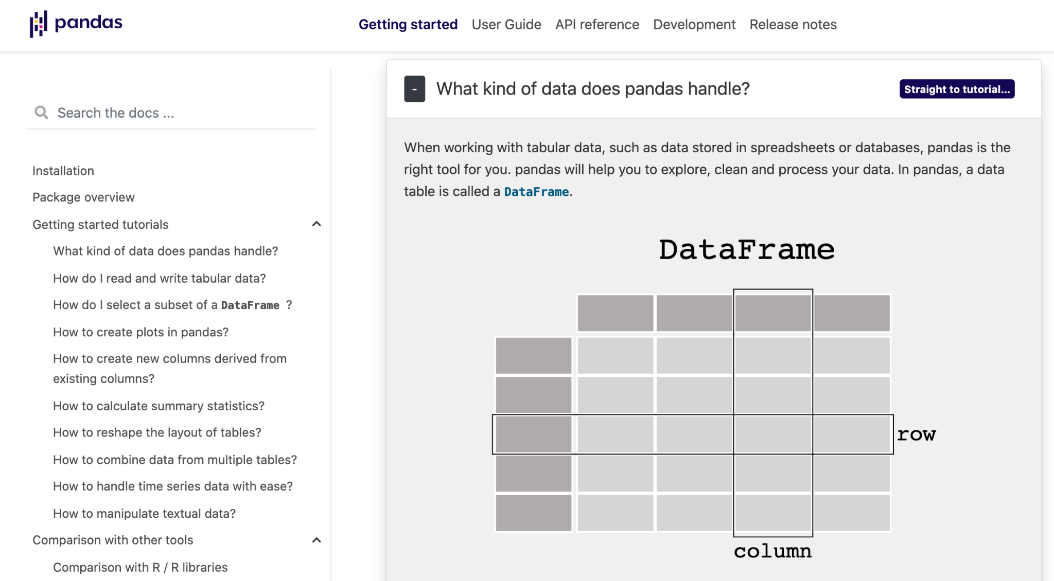
Pandas (1)
Pandas is a Python package providing fast, flexible, and expressive data structures designed to make working with “relational” or “labeled” data both easy and intuitive. It aims to be the fundamental high-level building block for doing practical, real-world data analysis in Python. The documentation is very straightforward to understand!
Check it out Pandas!
Page 07

Slide 9
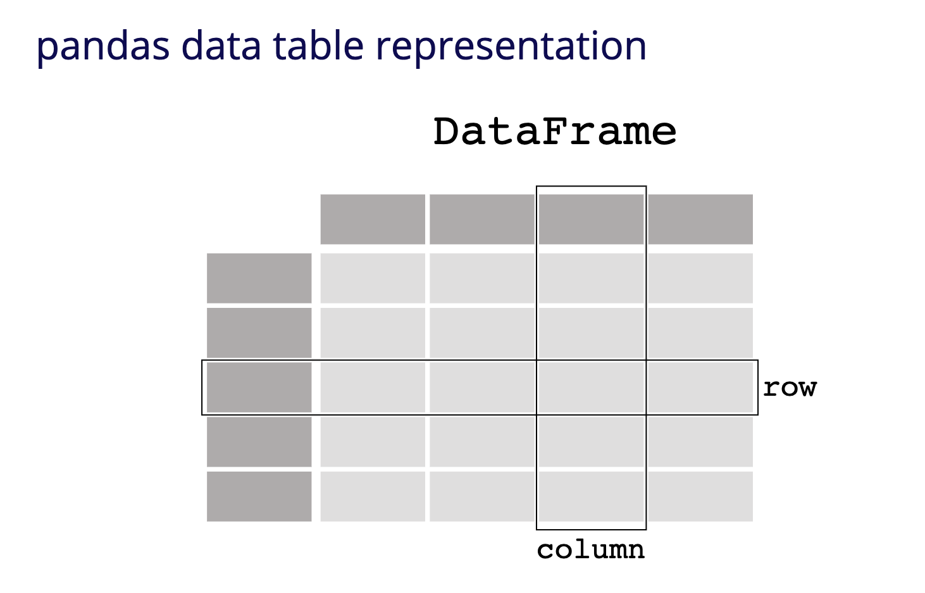
Pandas (2)
Pandas is a fast, powerful, flexible and easy to use open source data analysis and manipulation tool, built on top of the Python programming language.
Page 08

Slide 10

Pandas (3)
Each column in a DataFrame is a Series. When selecting a single column of a pandas DataFrame, the result is a pandas Series.
Page 09

Slide 11
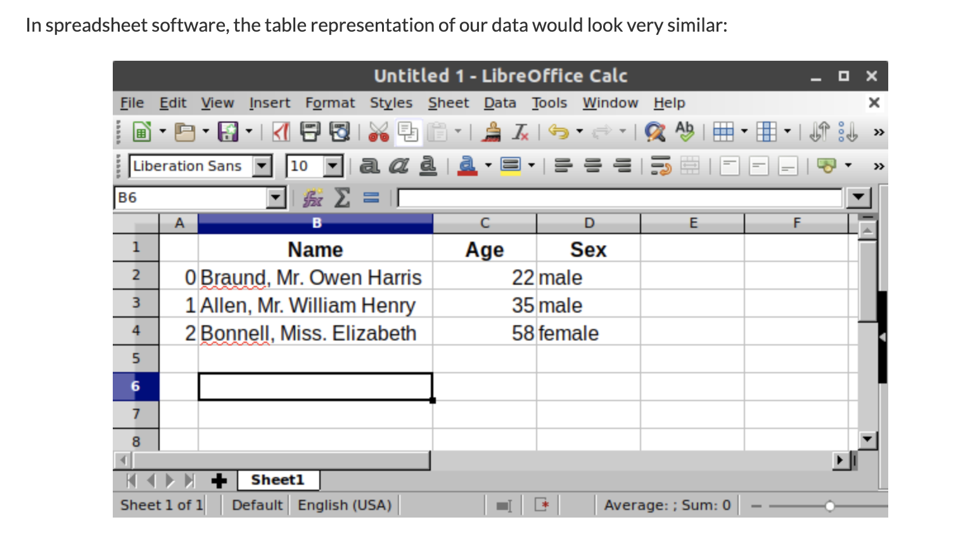
Pandas (4)
A DataFrame is a 2-dimensional data structure that can store data of different types (including characters, integers, floating point values, categorical data and more) in columns. It is similar to a spreadsheet, a SQL table.
Page 10

Slide 12
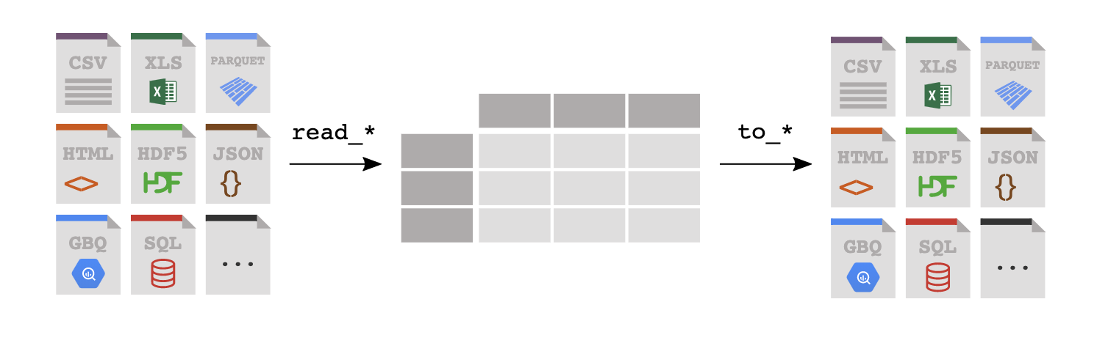
Pandas (5)
By using Pandas, we can work efficiently with the following type of tabular data:
CSV file
JSON file
Txt file
Excel file
Many others
Page 11

Slide 13
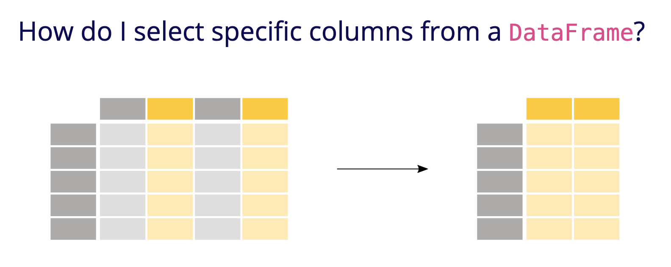
Pandas (6)
By using Pandas, we can read and write the value of the tabular data such as selecting, editing and removing specific value of the specific columns and rows
Page 12

Slide 14
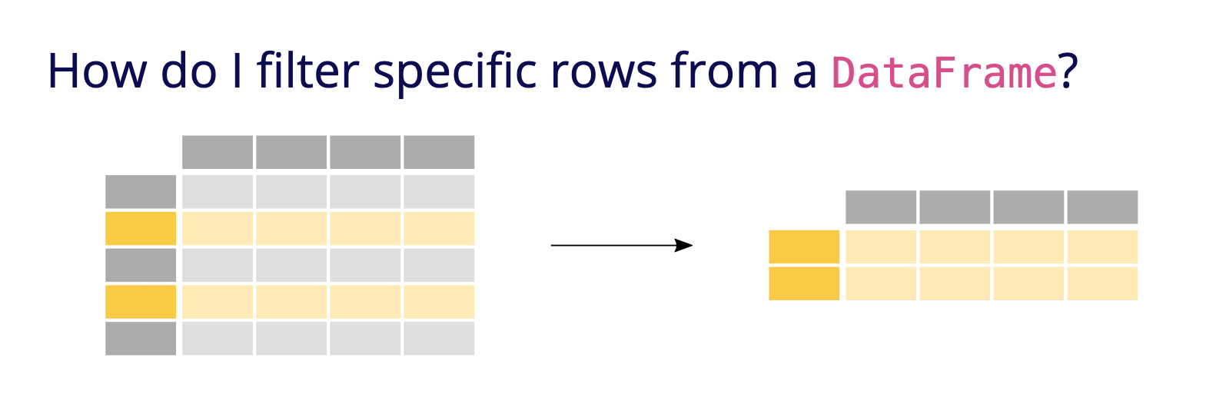
Pandas (7)
By using Pandas, we can read and write the value of the tabular data such as selecting, editing and removing specific value of the specific columns and rows.
Page 13

Slide 15
Terima Kasih!
Indonesia AI | AI for Everyone, AI for Indonesia
contact@aiforindonesia.org

